Slide 1

CAPSTONE PROJECT
SHRINIVAS RAJENDRA GRAMOPADHYE

Slide 2
THE NEED
This problem was conceived as it is relevant for the newbies in a huge city of Bangalore.
A friend of my requested me to look up for the likable locations in the city to stay as a bachelor.
As I was busy running behind my own dead lines at office; I could have hardly take out any small amount of leisure to help him out in this regard.
Due to this great limitation, I decided to help him by using my little programming skills.
Thus, this project…

Slide 3
THE PROBLEM STATEMENT
‘A list of neighbourhoods in the Bangalore which meet the criteria of the tenant in terms of locality and near by places is needed to be found out.’

Slide 4
THE CRITERIA
There were four desirable things that had to be the part of the locality in order to shortlist the same for consideration.
1. Gym
2. Restaurant
3. Bus Station
4. Multiplex
Taking these in to account, I was set off to shortlist the neighbourhoods..

Slide 5
THE PROCESS
Essentially a simple process was employed as I was too busy with my job assignments.
Yet, there was no compromise on the criteria set for the shortlisting.
A list of places was available at Wikipedia page for ‘Neighbourhoods in Bangalore’.
I webscraped that page using ‘read_html’ method.
Using ‘Foursquare’ API for looking up the near by places, I figured out the desired places in the selected locations.

Slide 6
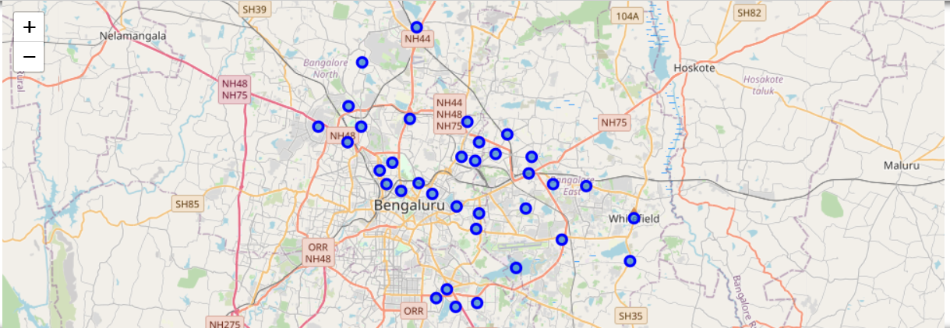
THE MAP
The Map showing initial list of neighbourhoods in Bangalore

Slide 7
THE PROCESS
Some of the places failed to meet one or the other (some times multiple) criteria.
The shortlisting was done by ‘intersection of sets’ method.
An interesting schematic shall follow..

Slide 8
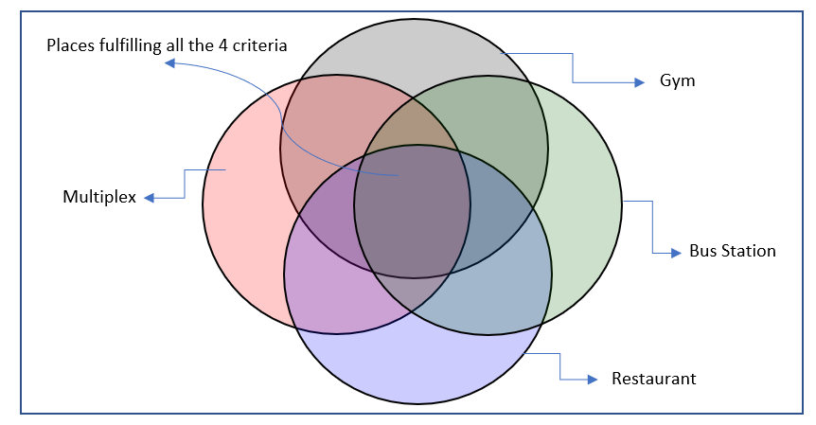
THE SHORTLISTING

Slide 9
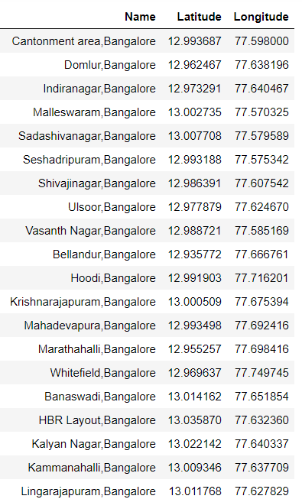
THE FINAL LIST
Here, I present a glimpse of the final list for a quick look over..

Slide 10
THE CONCLUSION
The places in the final list are 27 in total. Initially there were 40 neighbourhoods under consideration.
My friend has got a ready reference sheet to look up on his laptop to search and finalize the neighbourhood of his choice..

